Slide 1

Git Hub Home Work
Quations and Answers

Slide 2

How to resolve GIT conflict?
One of the most challenging yet common activities development teams run into with Git is resolving merge conflicts. This happens when multiple developers are making changes in a repository at the same time. This post provides a walkthrough of how to get through two typical Git conflict scenarios.
How to resove :
We can check “status” command.
Give pull and push command again for particular file and merge that file in Git repositery.

Slide 3

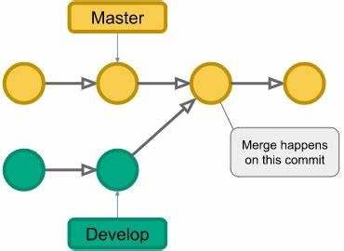
GIT branches needed?
Git branches come to the rescue at many different places during the development of a project. As mentioned above, branches create another line of development that is entirely different or isolated from the main stable master branch. There are many advantages to doing so.
One of the biggest advantages of Git is its branching capabilities.
Unlike centralized version control systems
Git branches are cheap and easy to merge.
This facilitates the feature branch workflow
popular with many Git users.
Feature branches provide an isolated
environment for every change to your codebase.

Slide 4

GIT Trunk
Trunk-based development is a version control management practice where developers merge small, frequent updates to a core “trunk” or main branch.
Branch of your repository. Trunk is a constant. In trunk based development, you either commit to the trunk branch, or make branches and pull requests against the trunk branch. There are no long lived alternative branches to merge against such as . I’ve seen teams create a new branch and call it the new “trunk” every few weeks.

Slide 5
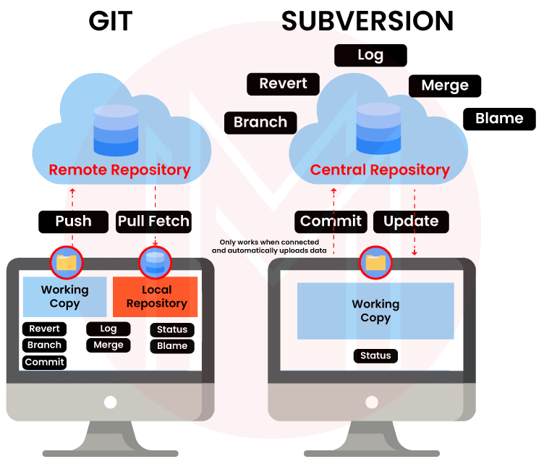
GIT V/s SVN
Git | SVN
GIT | SVN
Git is open source distributed vice control system developed by Linus Torvalds in 2005. It emphasis on speed and data integrity | Apache Subversion is an open source software version and revision control system under Apache license.
Git has a Distributed Model. | SVN has a Centralized Model.
In git every user has their own copy of code on their local like their own branch. | In SVN there is central repository has working copy that also make changes and committed in central repository.
In git we do not required any Network to perform git operation. | In SVN we required Network for runs the SVN operation.
Git is more difficult to learn. It has more concepts and commands. | SVN is much easier to learn as compared to git.
Git deals with large number of files like binary files that change quickly that why it become slow. | SVN control the large number of binary files easily.
In git we create only .git directory. | In SVN we create .svn directory in each folder.
It does not have good UI as compared to SVN. | SVN has simple and better user interface .
Features of GIT: Distributed System. Branching. Compatibility. Non-linear Development. Lightweight. Open source. | Features of SVN: Directories are versioned Copying, deleting, and renaming. Free-form versioned metadata . Atomic commits. Branching and tagging. Merge tracking. File locking.

Slide 6
GIT fetch vs Git Pull
Git Fetch | Git Pull
Gives the information of a new change from a remote repository without merging into the current branch | Brings the copy of all the changes from a remote repository and merges them into the current branch
Repository data is updated in the .git directory | The local repository is updated directly
Review of commits and changes can be done | Updates the changes to the local repository immediately.
No possibility of merge conflicts. | Merge conflicts are possible if the remote and the local repositories have done changes at the same place.
Command for Git fetch is git fetch<remote> | Command for Git Pull is git pull<remote><branch>
Git fetch basically imports the commits to local branches so as to keep up-to-date that what everybody is working on. | Git Pull basically brings the local branch up-to-date with the remote copy that will also updates the other remote tracking branches.

Slide 7
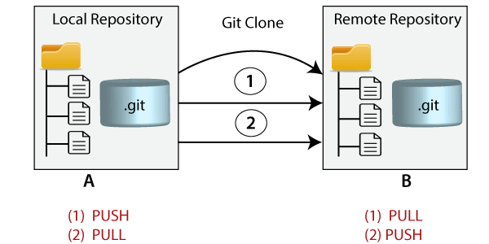
When GIT commit fails?
The usual thing is to use git commit --amend to replace the commit, then git rebase --continue to let Git continue with the rebase operation. However, you could also insert further commits, perhaps splitting the original changes up into several smaller commits.
How GIT clone command works?
Cloning a repository using the command line
Open “Git Bash” and change the current working directory to the
location where you want the cloned directory.
Type git clone in the terminal, paste the URL you copied earlier,
and press “enter” to create your local clone.

Slide 8
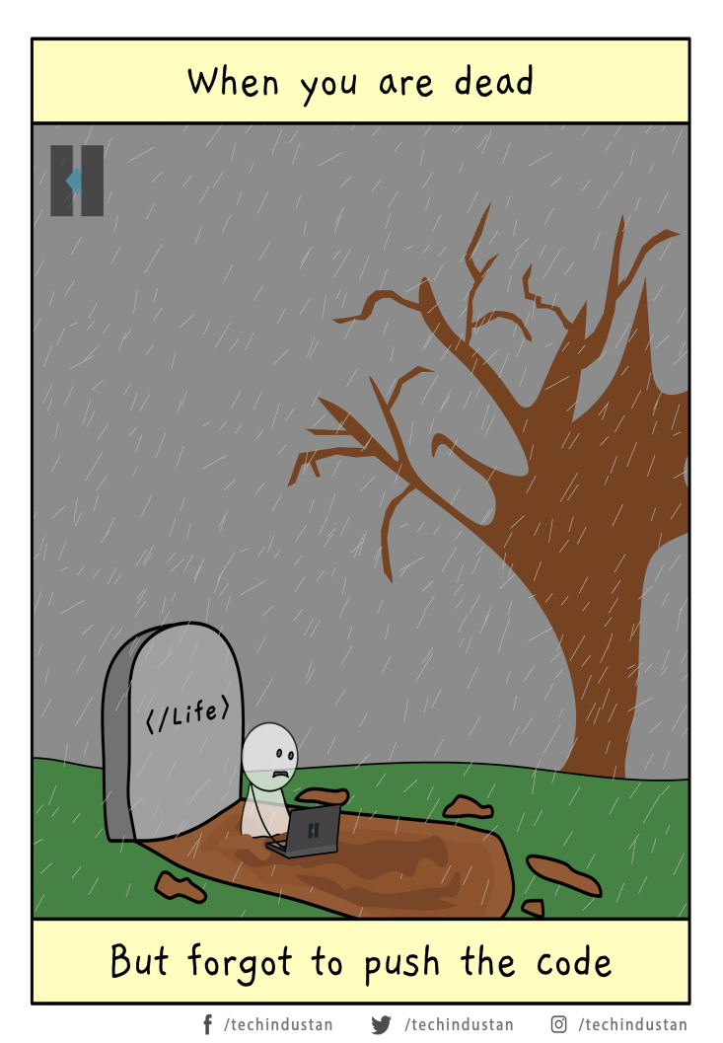
GIT update
* Open ‘Git Bash’ command prompt
* Write Git – Version Command and press enter
* You can check version of Git
GIT Challenges
1. Hardcoded sensitive data
2. Insecure Directories
3. Ignored
4. Unsigned commits
5. Insecure pipeline configuration
6. Git vulnerabilities
7. Unpatched software
8. Inaccurate access permissions

Slide 9








Git Market Competiter Tools
Azure DevOps Server.
Helix Core.
AWS CodeCommit.
Subversion.
Rational ClearCase.
Plastic SCM.
Mercurial.
Micro Focus AccuRev.

Slide 10


